Slide 1

Stage 3 Four Square Course Designer: Jordan Rogers
Four Square is a 25 round, 125 point Comstock long course. There are 10 USPSA targets and 5 steel targets. The best two hits per target will score. Steel must fall to score. The start signal is audible.
The handgun start position is standing with toes touching any barrel, handgun unloaded and holstered with wrist above shoulders. All ammunition loading devices to be used during the course of fire must be staged on a barrel prior to the start signal. The PCC start position is standing with toes touching any barrel, PCC unloaded with stock on belt, muzzle pointed down range. All ammunition loading devices to be used during the course of fire must be staged on a barrel prior to the start signal.
On the audible start signal, engage all targets as visible from within the shooting boxes.

Slide 2
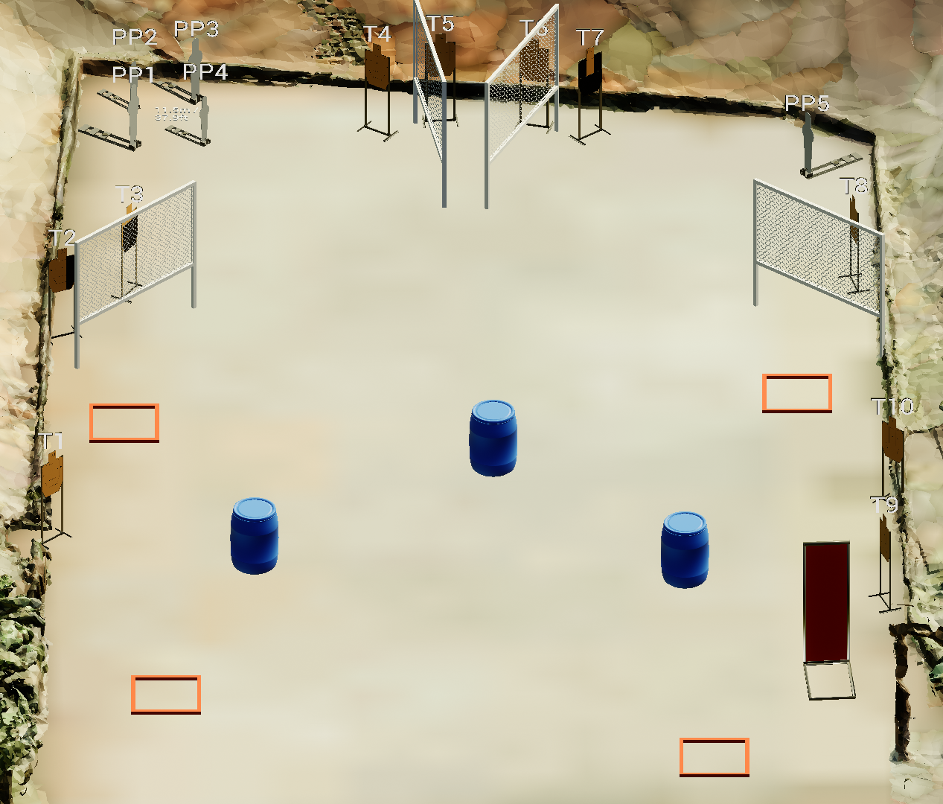
 | Stage 3 Four Square Course Designer: Jordan Rogers

